Slide 1
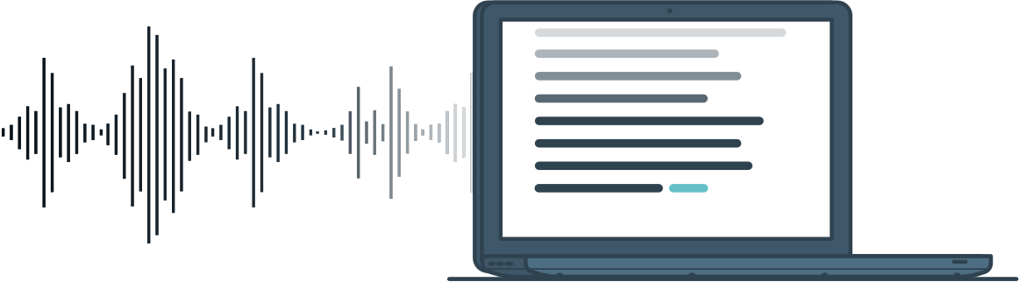
Audio to Action
Compiler
Adriel, Ado, Jovan, Ikhsan

Slide 2
Introduction (Background)
Audio to action has been implemented in many devices such as laptop and smartphone
This feature has the potential to change how people use their devices as things could be done more easily by using audio instead of typing and touch (E.g. People could text while driving safely by using audio to action).
The beneficiaries can extend from normal people to people with disabilities.
Hence, we find it interesting to be able to deconstruct voice to command and try to build it with our understanding of compiler..

Slide 3
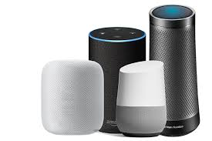
Related
Work

Slide 4
Problem Formulation
The scope of our project is only in the area of the compiler and parsing, thus we will not try to engage to machine learning in the speech recognition and text to speech.
We need to firstly convert the voice to text
From the text, we need to parse it for the computer to understand the string and alter it to be a command that the computer understand.
Then after parsed, we execute the command depending on the keywords from the voice by directing them to functions and libraries we use and make

Slide 5
Strategy to solve the problem
Create a program where the program will return the converted user’s audio to text by using some python module.
The text from conversion will go through parser using PLY as to be tokenized,thus easier to be converted to command.
Then commands are executed by libraries and made-functions
Implementing more commands for the program (e.g. Play music, read documents, open applications, search the internet, etc).
Error recognition to realize false input through text-to-speech for an easier to understand feedback towards the user.

Slide 6
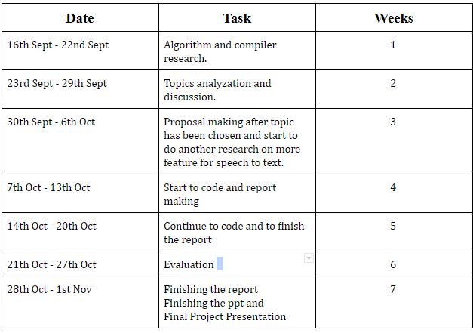
Timeline

Slide 7
Proof of correctness

Slide 8
Command | Expected Result
Open Application (Chrome, Spotify) | The program will open a recognized application within your system.
Play music (music.mp3) | The program will play the music that was inputted, by searching for the music file in the directory provided in the code.
Search something (any keyword) | The program will open google chrome and search for the keyword input using google.
Write a note | The program will open notepad and writes the input keyword(s) in.
Open application and/then search something | The program will open a recognized application within your system. If that application is a web browser, then that browser will then search the input keyword.
Stop music (music.mp3) | The program will terminate the current music file that is playing. The command will not result in anything if there are no music currently being played.
Open document | The program will search for a document in your system that matches the keyword input and then promptly opens it.

Slide 9
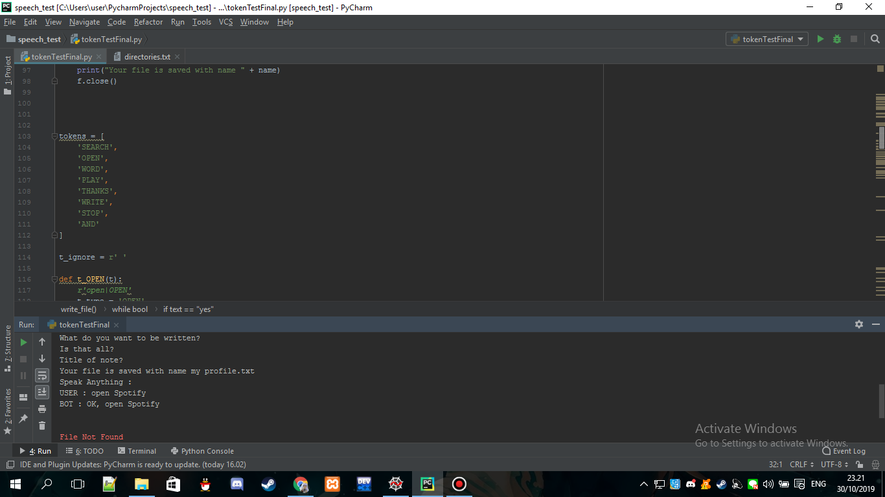
Tokens

Slide 10
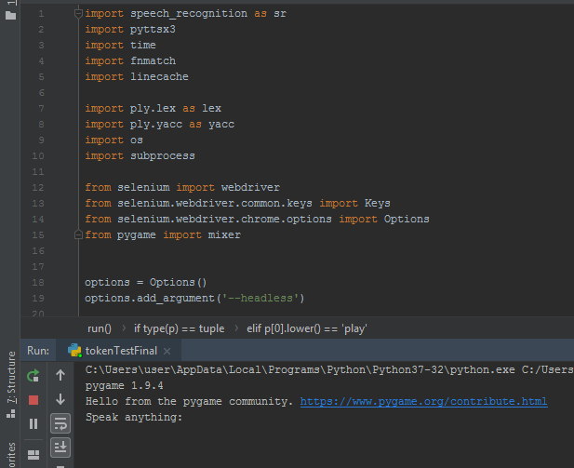
Imports

Slide 11
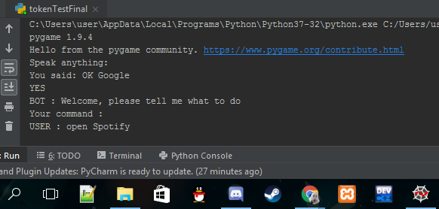
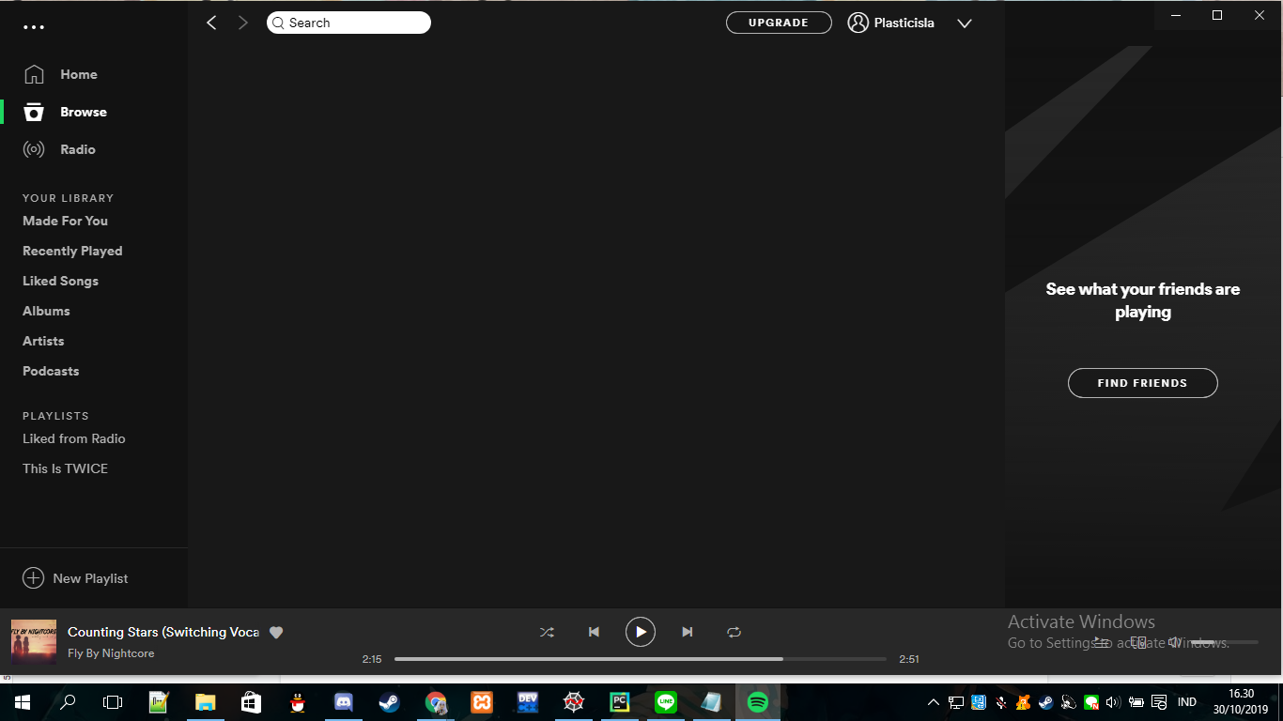
Result

Slide 12
Result and Discussion
Implemented selenium to open browser and return search results from google (which will shortly be implemented to be used with audio)
In terms of audio to text, we found a suitable api to support our tokenizer.
We used an API called pyttsx 3 for text response in order to support our finalization of the code and for easier error recognition.
Created several commands that we planned initially, such as open application,play music, reading files and create notes from scratch.

Slide 13
Code Demonstration

Slide 14
Conclusion
We successfully created the codes that can run independently. (audio to text, text to audio, audio command, and tokenizer parser for the commands).
The APIs for both speech-to-text and text-to-speech requires online connection even though the code itself would be much faster executed when using offline libraries. However, offline libraries for speech recognition exceeded our scope of problem.
Our code’s efficiency in execution relies on the effectiveness of the library of speech recognition that we use.

Slide 15
THANK YOU

